Slide 1
Technology and History
Leadership

Slide 2
Consider the Hypothesis:
“In recent years, Technology is changing our lives faster than ever before”
Notes:
vote

Slide 3
Is this Hypothesis true?
Consider other periods of time
Notes:
vote

Slide 4
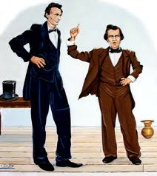
Consider the election of 1860
Lincoln vs Douglas Nov 6, 1860
Abraham Lincoln voted at the Sangamon County Court House in Springfield, Illinois in mid-afternoon, modestly cutting his own name from the ballot.
That evening he went to the local telegraph office and waited for reports on election returns from across the country.
“Those who saw [Lincoln] at the time,” as the New York Times observed, “say it would have been impossible for a bystander to tell that that tall, lean, wiry, good-natured, easy-going gentleman…was the choice of the people to fill the most important office in the nation.” (By Don Sailer)

Slide 5
Consider the election of 1860
By midnight, he knew he had won because of key state returns, New York and Pennsylvania
https://www.smithsonianmag.com/history/election-day-1860-84266675/

Slide 6
This speed was made possible by the invention and deployment of the telegraph

Slide 7
Impact of Telegraph
1838 Patent
1851 75 companies 21000 miles of wire
1854 All Major Cities connected
1864 100,000 miles
Before the telegraph, information travelled at the rate of a train (1835) or a horse

Slide 8
So it is fair to say
Previous elections did not give the one-day results that was possible in 1860.
As a result there was a four month delay because of the tiem to count the ballots and to travel to Washington.

Slide 9
Consider. . .
What was in common use at the end of a decade

Slide 10
Consider. . .
What was in common use at the end of a decade
And in rare use (or unknown at the beginning of the decade?

Slide 11
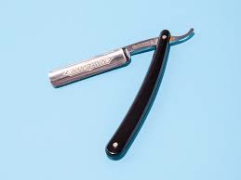

Inventions
1910 | Safety razor, ductile tungsten

Slide 12
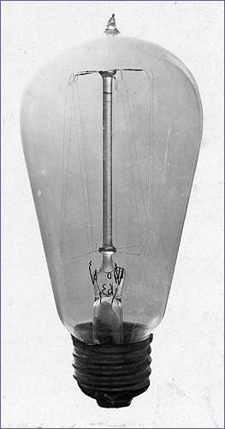
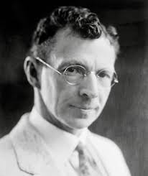
Inventions
1910 | ductile tungsten provided rugged efficientelectrical lighting
William Coolidge

Slide 13

Inventions
2020 | ??
1920 | Airplanes

Slide 14
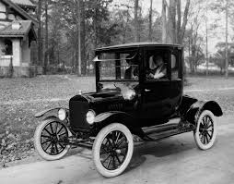
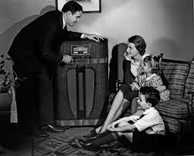
Inventions
2020 | ??
1930 | Cheap Cars, Radio, Home appliances, short wave radio, Insulin for Diabetics

Slide 15
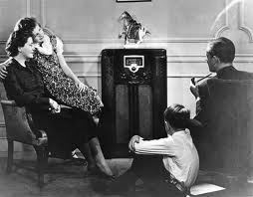
1920s
Between 1923 and 1930, 60 percent of American families purchased radios

Slide 16
Cars
In 1929 5.3 M cars shipped a record until 1949
Cars went from a luxury good to common use

Slide 17
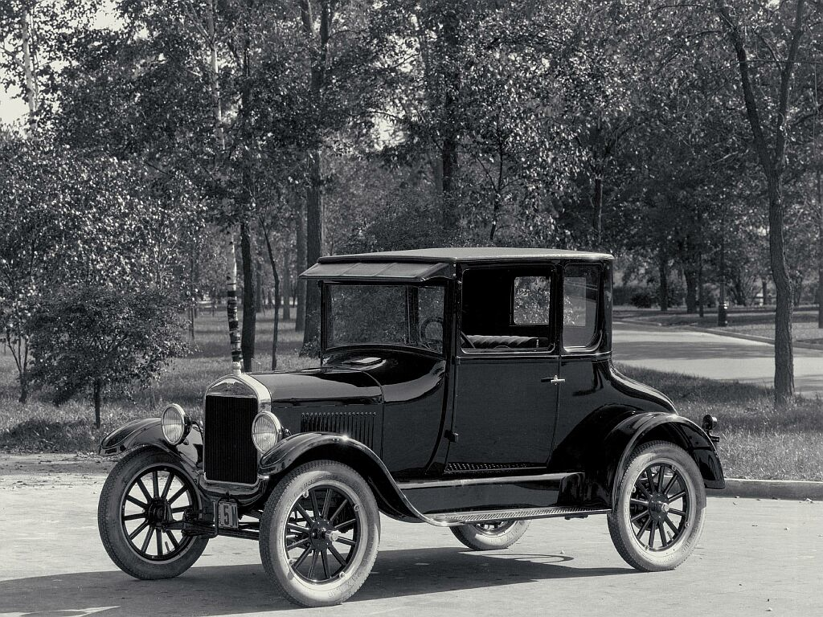
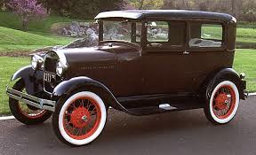
1920s
Model T
Model A

Slide 18
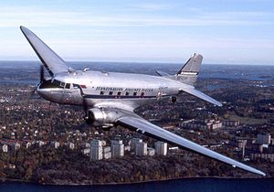
The growth of commercial air passenger transport
1940 | Nylon, Air transport

Slide 19
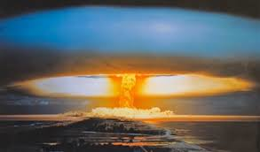
Inventions
1950 | Computer, kidney dialysis, nuclear weapons, microwave oven, transistor, Antibiotics

Slide 20
Inventions
1950 | Computer: Alan Turing “Colossus” Code Breaker Bletchly Park; ENIAC general purpose computer(1946)

Slide 21

Inventions
1950 | Computer, kidney dialysis, nuclear weapons, microwave oven, transistor, Antibiotics

Slide 22
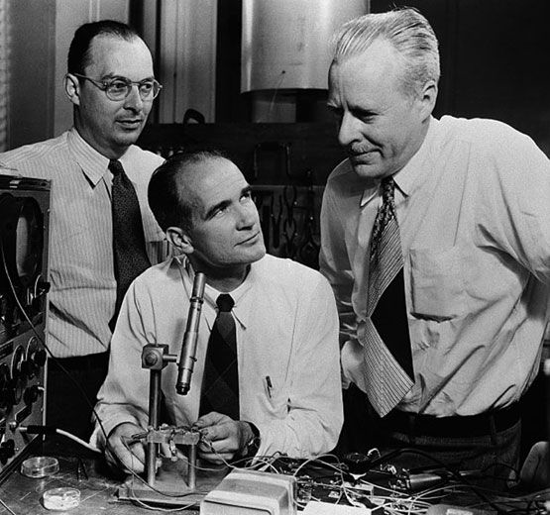
Inventions
1950 | Transistor, Brattain Bardeen Shockley

Slide 23
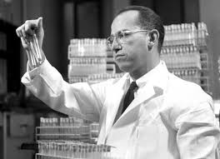
Inventions
1960 | Computer Languages. Jet Planes for Transport, Video Tape Recorder, Transistor Radio, Oral Contraceptives, Solar Cell, Polio vaccine

Slide 24
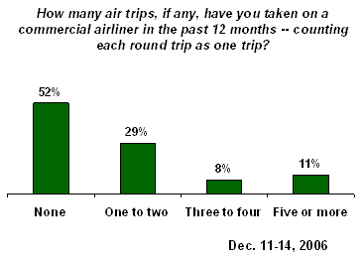
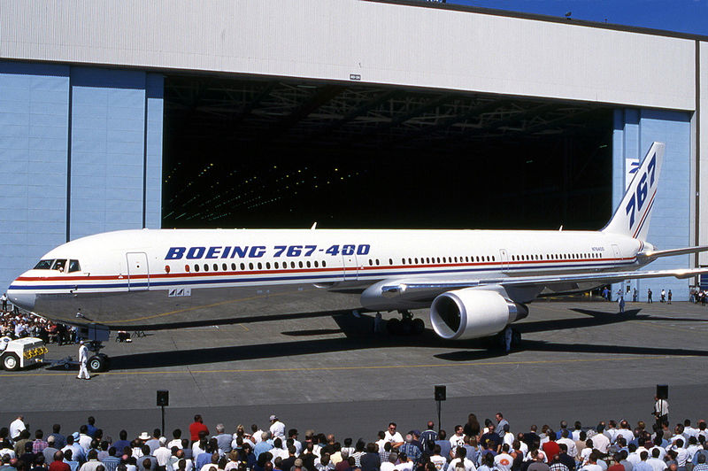
Flying frequency
http://www.gallup.com/poll/26134/Security-Hassles-Airports-Air-Travelers-Biggest-Complaints.aspx

Slide 25
But when did this really start?
"For the first time the ordinary man began to fly with us," observed Juan Trippe, longtime head of Pan American.
Traffic Jams in the Sky
So many ordinary people began to fly that the industry had to struggle to serve them.
Boardings more than doubled from 17.3 million in 1950 to 38 million in 1958.
By 1955 more Americans were traveling by air than by railroad.

Slide 26
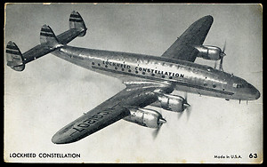
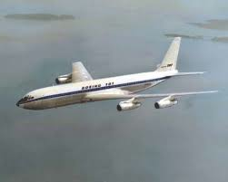
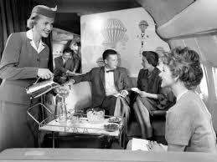
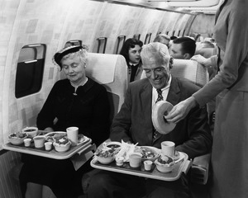
Transition in the 50s

Slide 27
1957-2013
Speed Essentially the same
Fuel economy
  1960 and 2000 55% overall fuel efficiency gain
Aviation Safety – fatal accidents
  1950s and 1960s once every 200,000 flights.
  2013 once every 2 million flights.
  2017 no fatalities

Slide 28
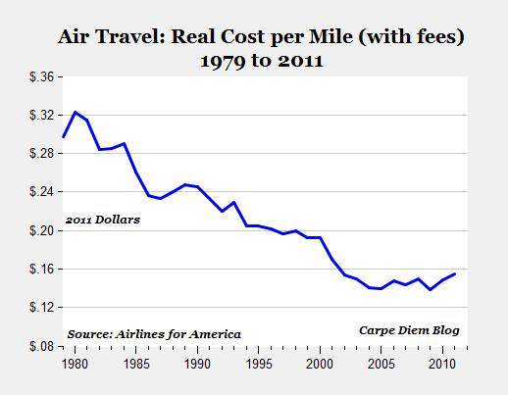
Cost dropped with de-regulation

Slide 29
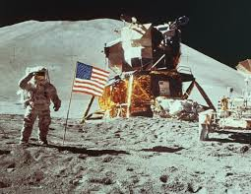
Inventions
1970 | Space Travel, Satellite Communication, photocopier, room air conditioning, laser, IC, audio cassette, Arpanet,
1970 | S

Slide 30
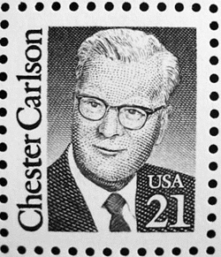
Inventions
1970 | Space Travel, Satellite Communication, photocopier (Xerox), room air conditioning, laser, IC 4K RAM, audio cassette, Arpanet,

Slide 31
Inventions
The first handheld calculator was invented at TI in 1967. The project was code-named Cal Tech. This model, which shows the application of TI's thermal printhead to the calculator, resides today at the Smithsonian in Washington, D.C.
1980 | Hand held calculator, microprocessors, word processors, Ethernet, Visicalc (excel), wide popular air travel

Slide 32

Inventions
1990 | PCs, “Supercomputer”, walkman,

Slide 33
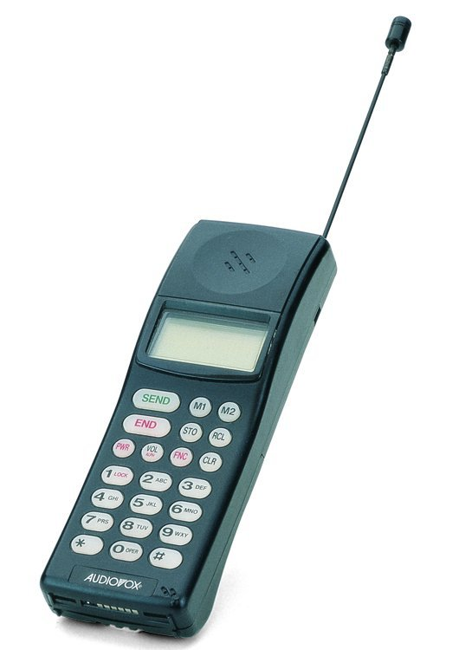
Inventions
2000 | Cell Phones, Internet, GPS, free phone calls,

Slide 34

Inventions
2000 | Cell Phones, Internet, GPS, free phone calls,

Slide 35
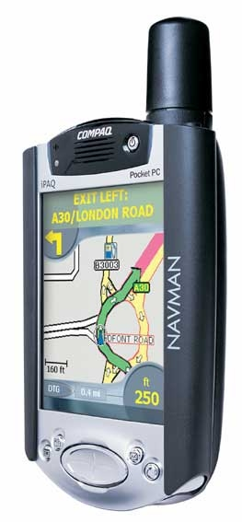
Inventions
2000 | Cell Phones, Internet, GPS, free phone calls,

Slide 36

Inventions
2010 | Social Networking, pocket computer (Iphone), YouTube

Slide 37
Inventions
2019 | You tell me
24 hour personal connectivity

Slide 38
Inventions
2019
24 hour personal connectivity
Social Networking
Smart Houses

Slide 39
Inventions
2030 | You tell me

Slide 40
Inventions
2020 | ??
2010 | Social Networking, pocket computer (Iphone), YouTube
2000 | Cell Phones, Internet, GPS, free phone calls,
1990 | PCs, “Supercomputer”, walkman,
1980 | Hand held calculator, microprocessors, word processors, Ethernet, Visicalc (excel), wide popular air travel
1970 | Space Travel, Satellite Communication, photocopier, room air conditioning, laser, IC, audio cassette, Arpanet,
1960 | Jet Planes for transport, Video Tape recorder, transistor Radio, oral contraceptives, solar cell, Fortran, Polio vaccine
1950 | Computer, kidney dialysis, nuclear weapons, microwave oven, transistor, Antibiotics
1940 | Nylon, Air transport
1930 | Cheap Cars, Radio, Home appliances, short wave radio, Insulin for Diabetics
1920 | Airplanes, zipper, frozen food
1910 | Safety razor, ductile tungsten

Slide 41
However, there is one thing that characterizes technology now

Slide 42
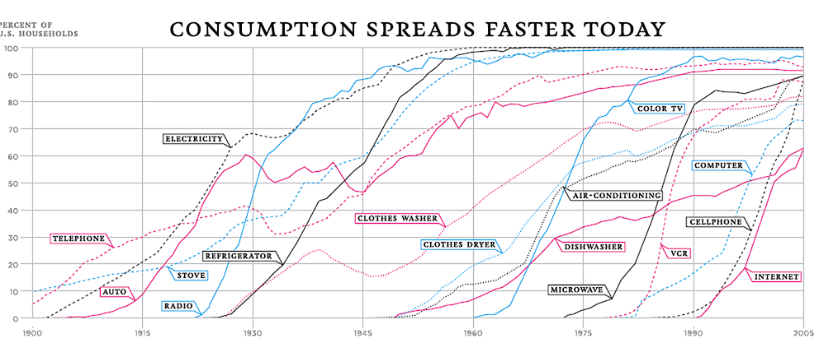
Derek Thompson Atlantic Magazine April 7, 2012

Slide 43
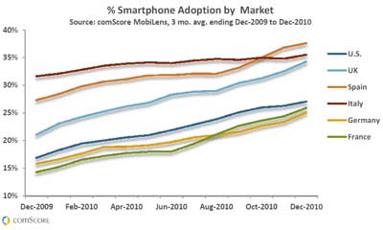
Smart Phones

Slide 44
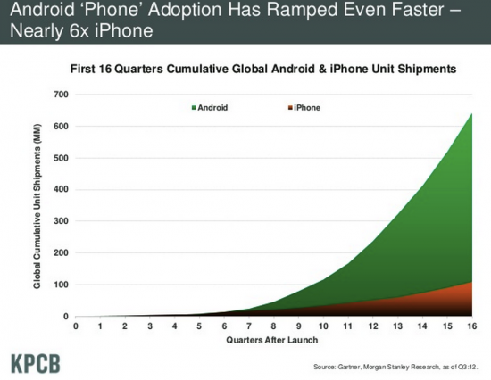
Smart Phones

Slide 45
Smart Phone Penetration India
-Statistica
 | 2010 | 201 | 2012 | 2013 | 2014 | 2015 | 2016 | 2017
% | 3 | 5 | 9 | 14 | 20 | 25 | 28.5 | 32

Slide 46
Can you have predicted this?
Perhaps easier when a product is already launched and accepted.
Hard at the very beginning

Slide 47
Missed Forecasts at the beginning
A “reasonable” forecaster would not have predicted
The computer in 1940
The transistor in 1945
The Laser in 1950
Comsats in 1955
LSI in 1960
Handheld calculators and microcomputers in 1965
Cellphones in 1980
The Internet in 1990

Slide 48
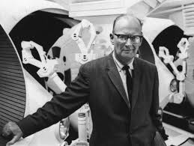
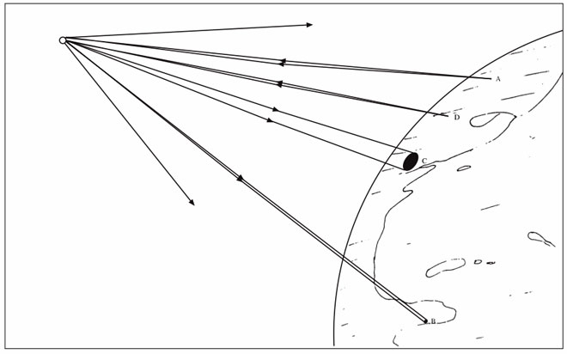
With Exceptions
Consider Arthur C. Clarke
“Extra-Terrestrial Relays: Can Rocket Stations Give World-wide Radio Coverage?”
– Wireless World Oct, 1945

Slide 49
2030
Cancer commonly cured
Drone delivery
Quantum computing
Common Autonomous vehicles
Zero emission transport
Greatly improved Medical diagnosis

Slide 50
Why is it hard to predict technology change?
Technologies evolve and rates can be difficult to predict.
  Effect of long product cycles (such as military- except in War)
Transition from science to engineering is easy to get wrong

Slide 51
The wrong way to control risk
A Product Delivery Process with “Science”
Pre-
Concept
Concept
Detailed
Design
Manufacture
Manufacture
Support
After-
Market
Service

Slide 52
The wrong way to control risk
A Product Delivery Process with “Science”
Pre-
Concept
Concept
Detailed
Design
A Miracle
Happens
here!
Manufacture
Support
After-
Market
Service

Slide 53
Technology Maturity
Science
is not the same as Engineering
Can the Technology be manufactured with
known manufacturing processes?
Are the critical parameters that control the
new Technology’s functions identified?
Are the safe operating ranges known?
Have the failure modes been evaluated?
Have the life cycle effects been evaluated?
Are the environmental effects known?
If yes, engineering. If no, science

Slide 54
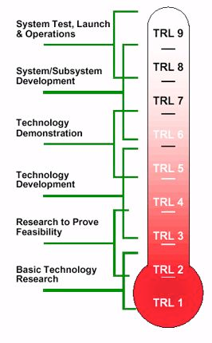
JPL Technical Readiness Level

